Slide 1
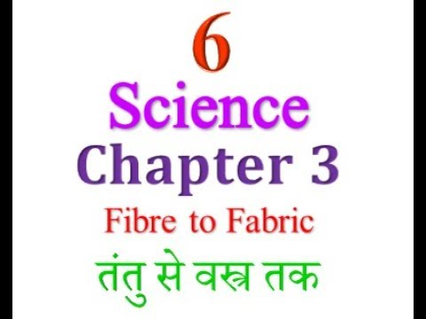

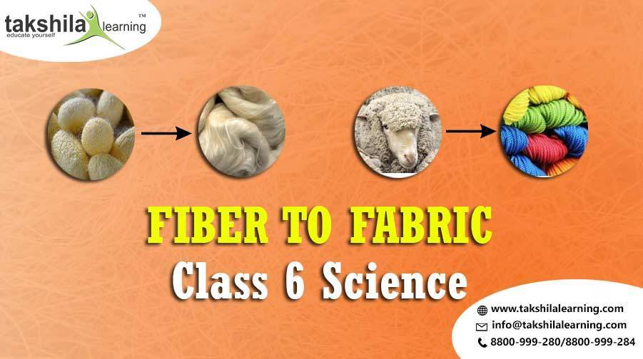

Slide 2
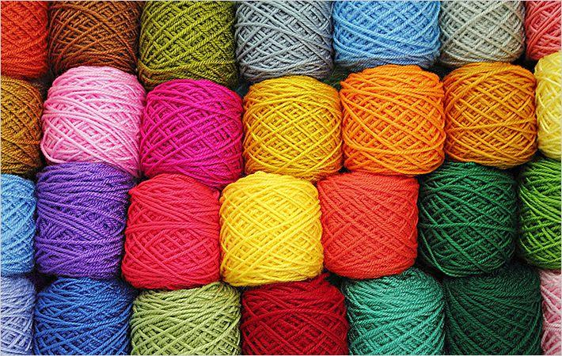
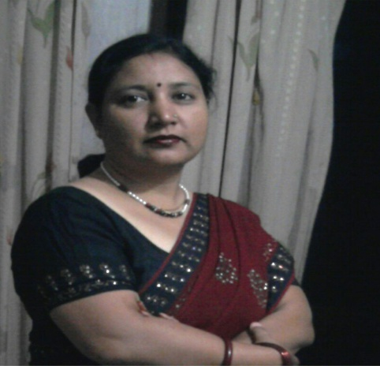
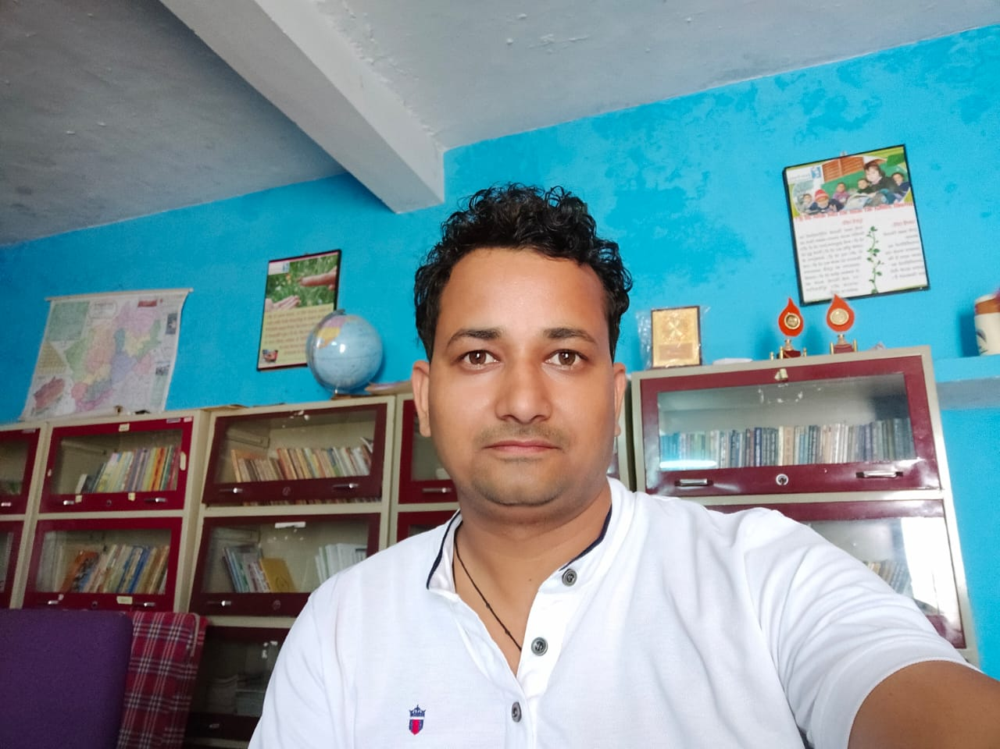
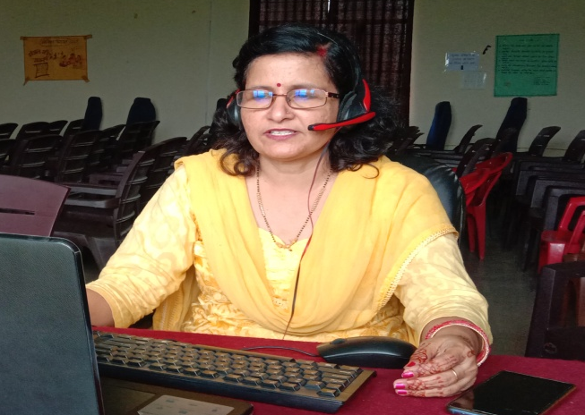
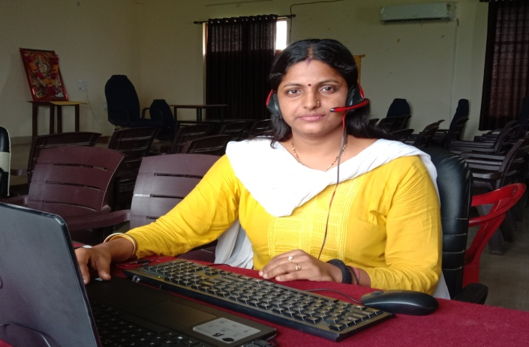
PRESENTED BY :-
ANITA RAWAT
ASSISTANT TEACHER G.U.P.S. CHAKONI, Rudrapur
EDITED BY :-
JEEVAN SINGH NEGI
ASST. TEACHER
GPS BAIGUL DAM KHATTA, SITARGANJ
SOUND RECORDED BY :-
SEEMA TRIVEDI
LECTURER DIET U.S. NAGAR
CHETNA MISHRA
LECTURER DIET U.S. NAGAR
DIET U.S. NAGAR
PROVED BY :-
LECTURER DIET U.S. NAGAR
PREPAIRED BY :-
E.T. DEPARTMENT, DIET U.S.NAGAR, RUDRAPUR

Slide 3

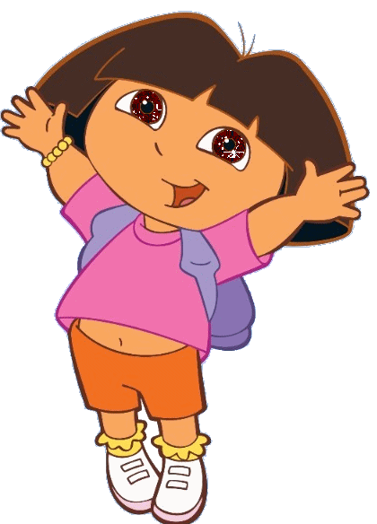
HURREY! We have won the first prize in science quiz. papa mummy will be very glad
Lets buy clothes for them.

Slide 4
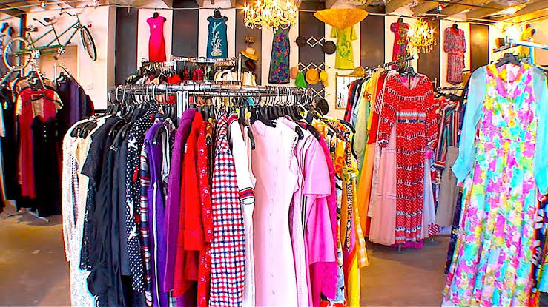
Wow! So many clothes of different fibres.
I am totally confused. let’s ask the teacher about fabric. but before asking we should collect cuttings of different types of fabrics from the tailoring shop

Slide 5
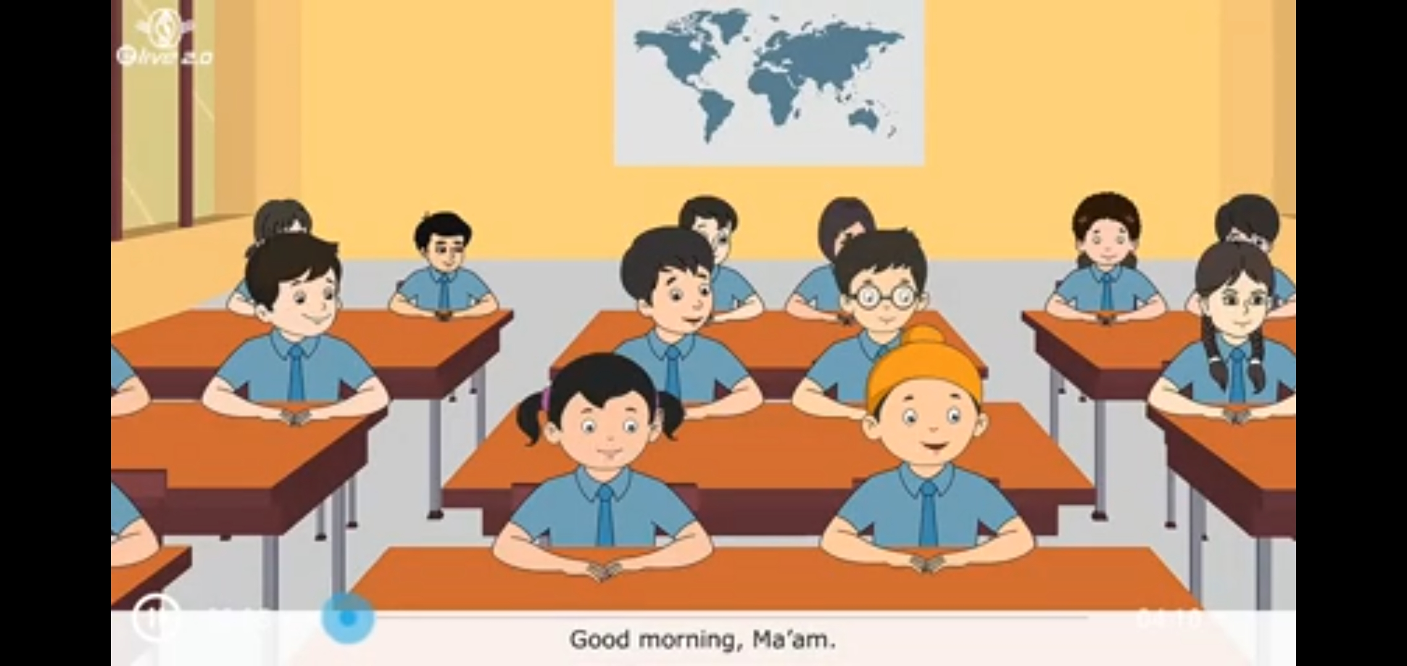
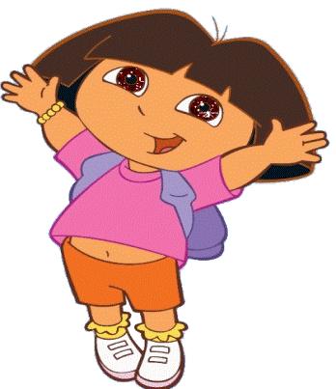

Mam what is fabric?we have collected many kinds of fabrics from the tailoring shop
OK.feel and touch every piece of fabric.Now try to label some of the as cotton, silk, wool, jute and synthetic.
Good morning mam. I have a question.
Good morning paheli . what is your quarry?

Slide 6
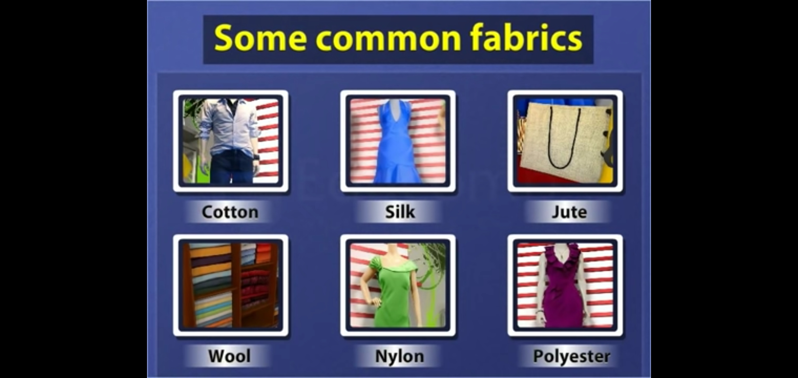

Slide 7
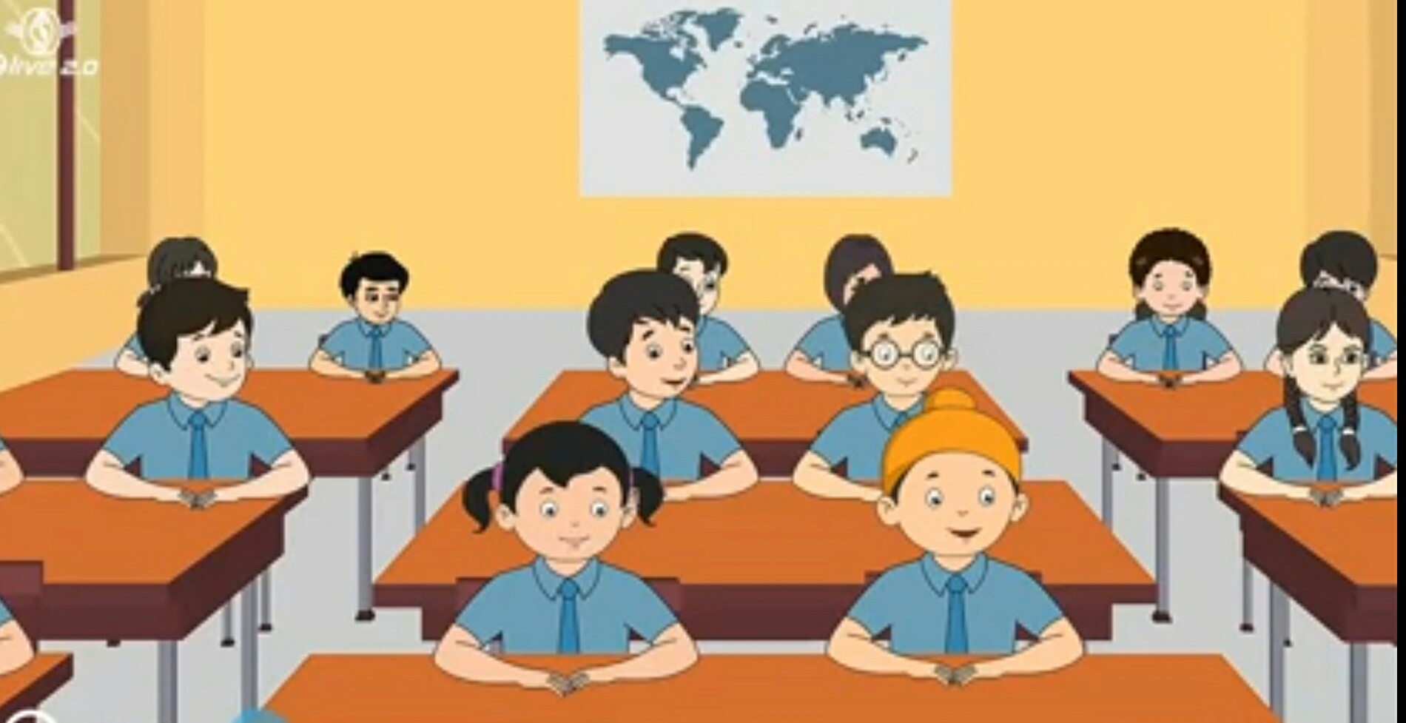
Are all students are ready for the activity?
Bujho! To understand this we will do some activity.
Mam , How are the fabric made?
Yes Mam

Slide 8
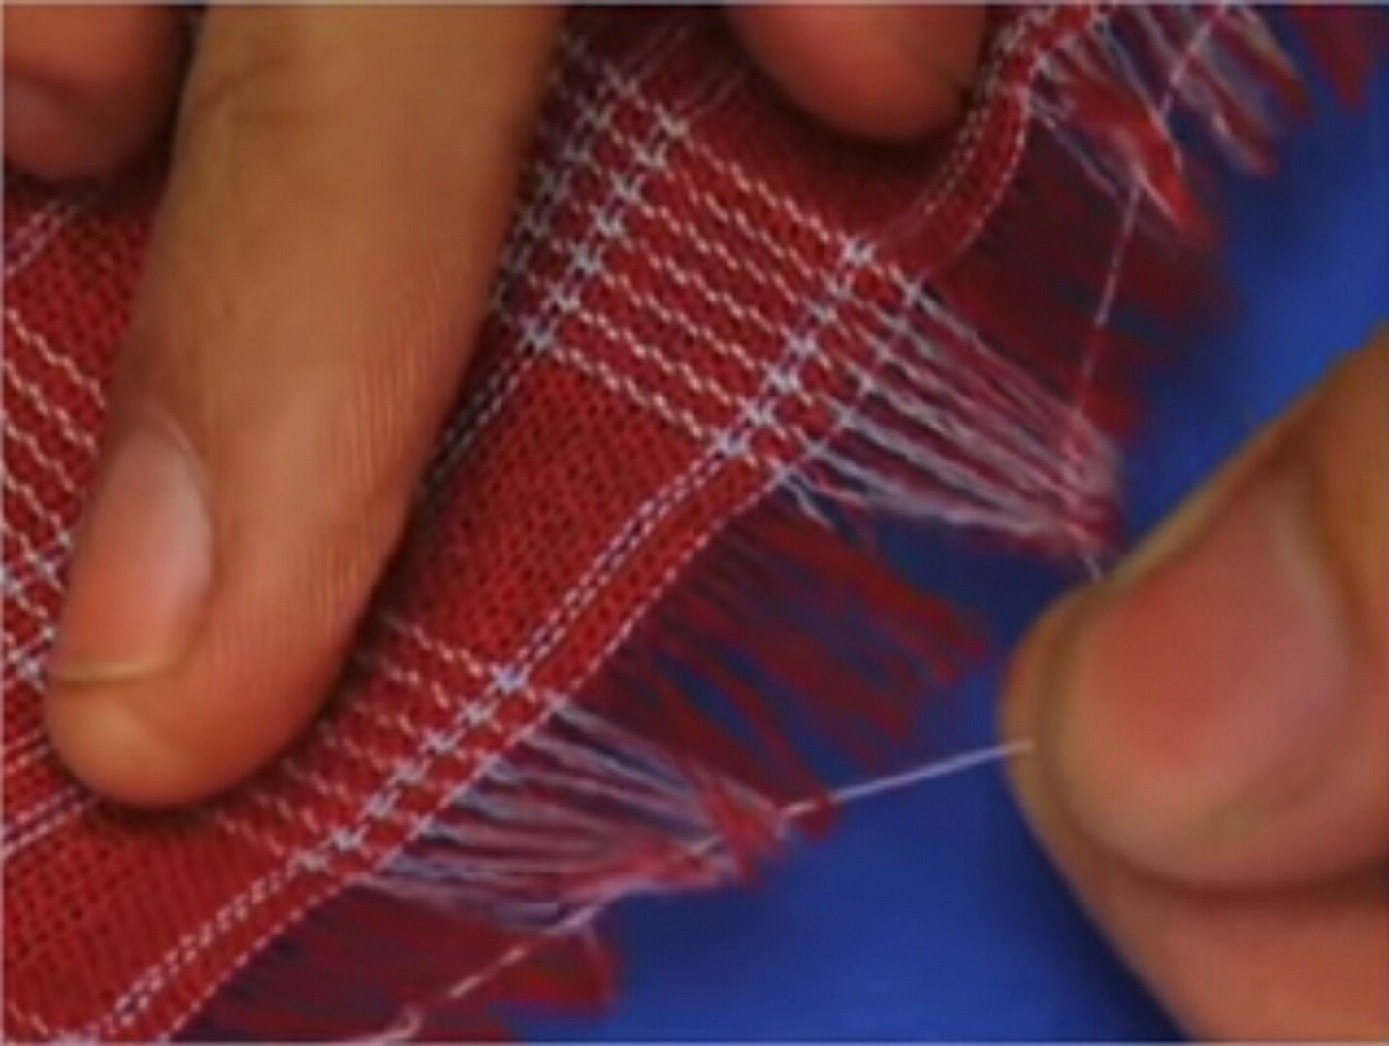
Take a cotton cloth. Try to pull out a loosen thread of it. This is called yarn.

Slide 9
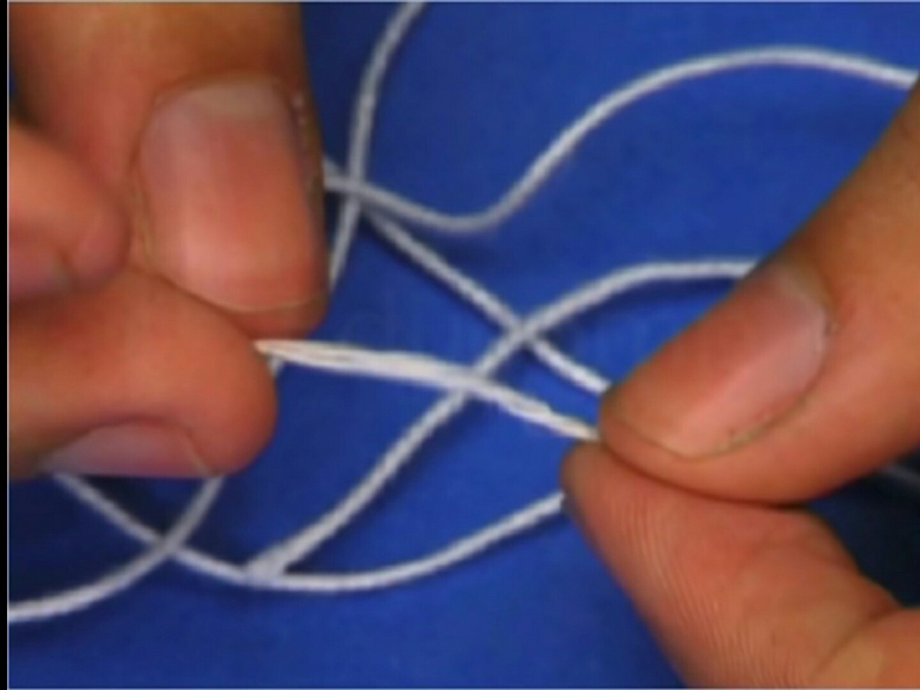
Split up the yarn into thin strands. These thinner strands are called fibre.

Slide 10
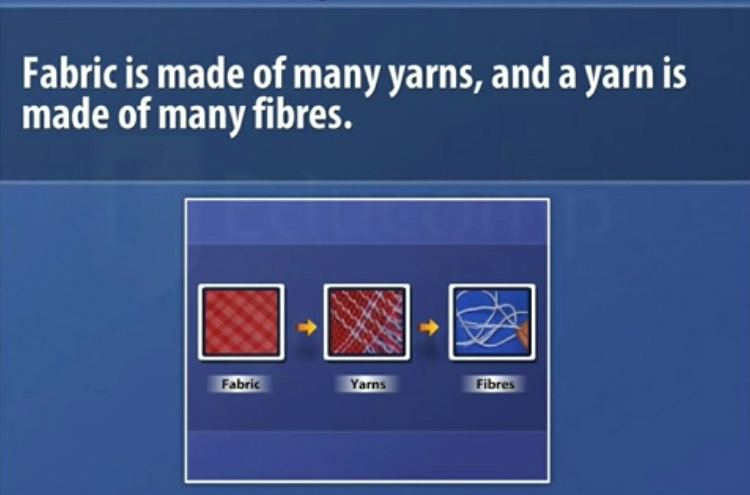

Slide 11
Mam ! From where do we get these fibres?
O.K.
I explain you

Slide 12
ON THE BASIS OF THE SOURCE
FIBRES ARE OF TWO TYPES
NATURAL FIBRES
SYNTHETIC FIBRE

Slide 13
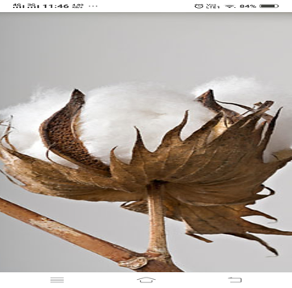
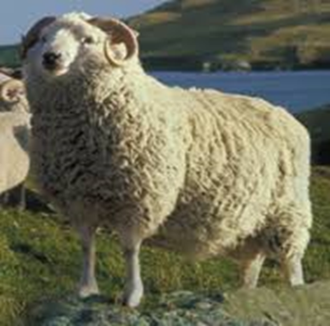
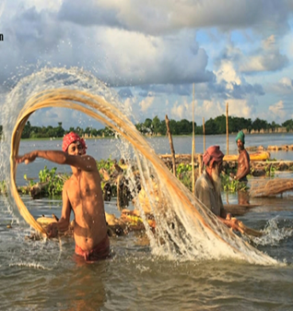
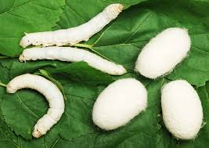
NATURAL FIBRES
PLANT FIBRE
ANIMAL FIBRE

Slide 14
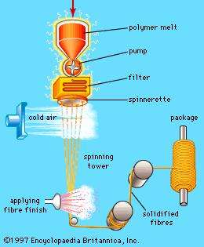
SYNTHETIC FIBRE
REYON
POLYSTER
NYLON
ACRYLIC

Slide 15


Mam! How do fabrics are made from fibres ?
O.K. Children! Lets know how the fabric are made from fibre .

Slide 16
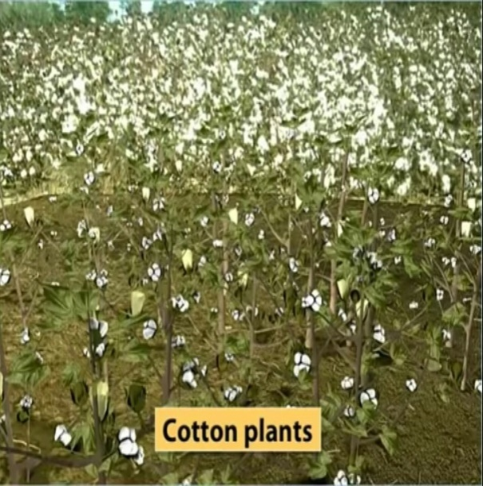
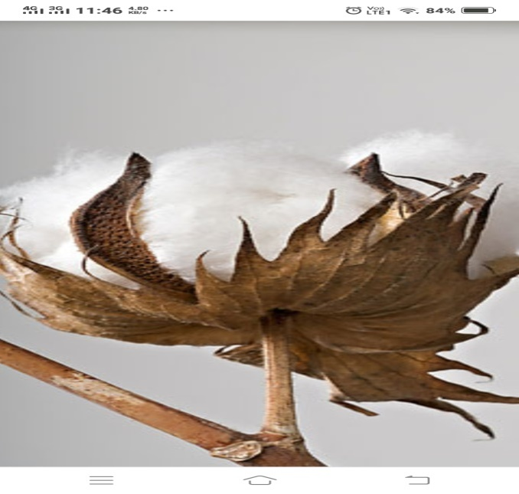
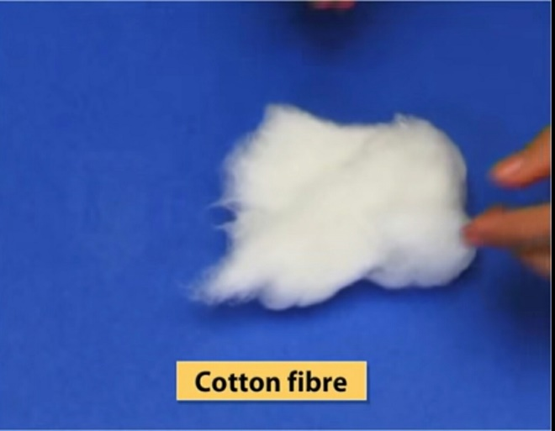
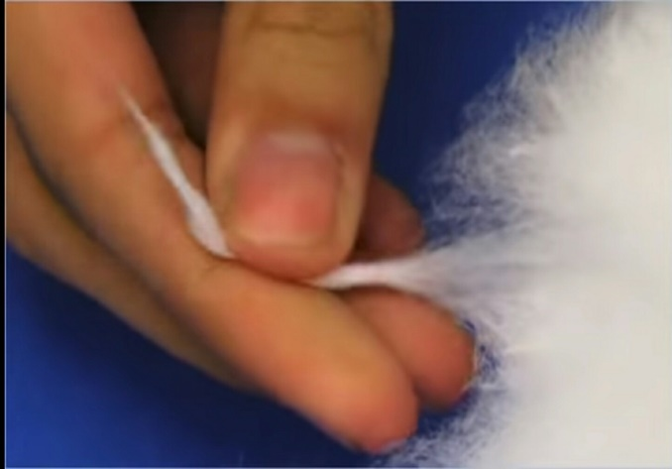
MAKING OF COTTON FABRIC

Slide 17

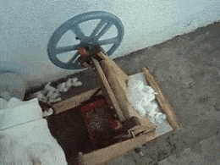
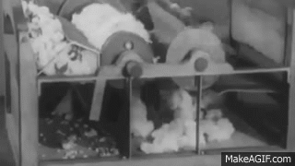
PROCESS OF GINNIG
COTTON BALLS HAVE SEEDS.
THE PROCESS OF SEPARATING SEEDS FROM COTTON BALL IS CALLED GINNING.
BY HAND
BY MACHINE

Slide 18
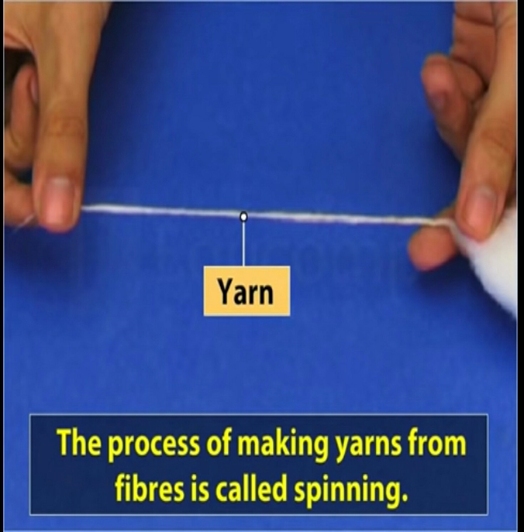

Slide 19
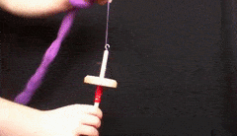
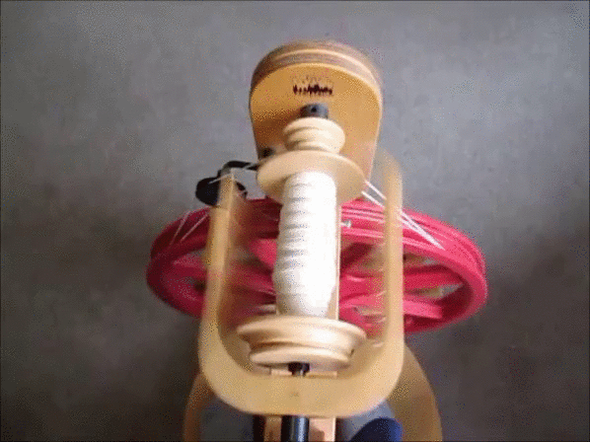
SPINNIG TOOLS
SPINDLE
SPINNING MACHINE

Slide 20
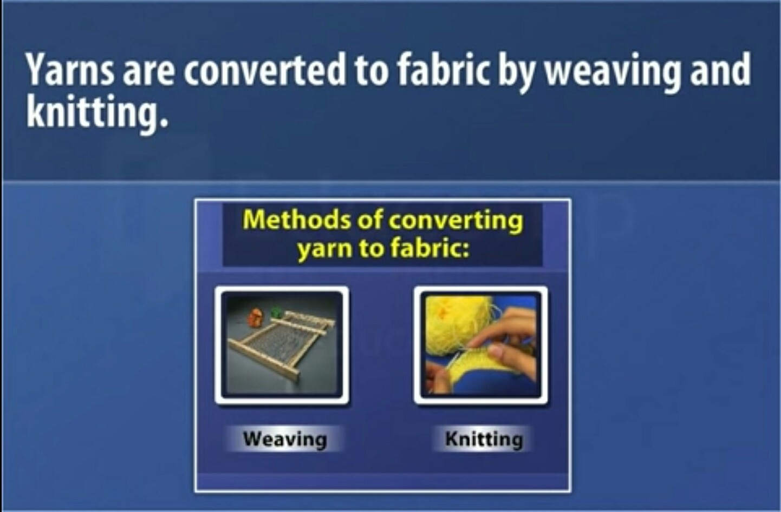

Slide 21
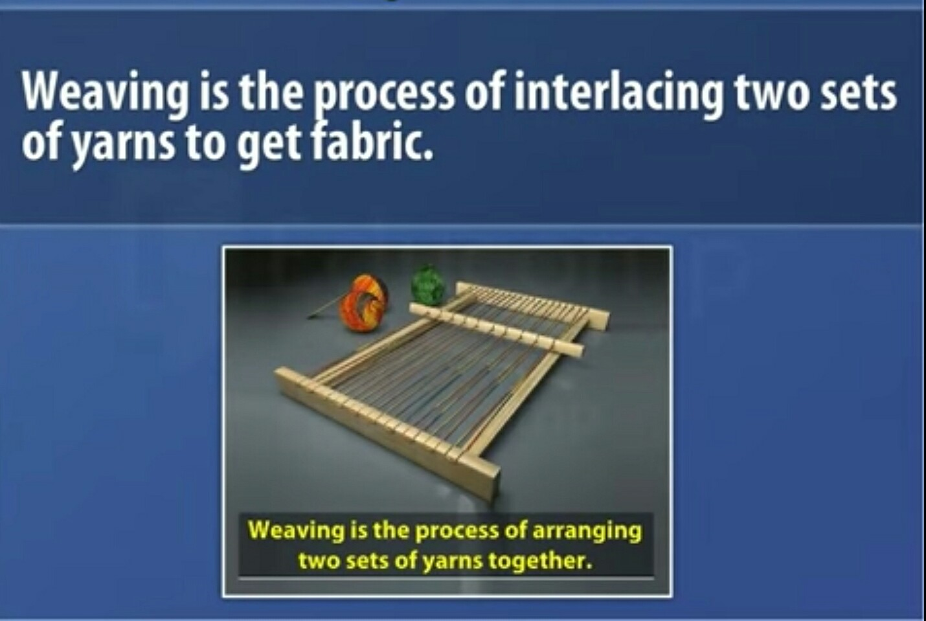

Slide 22
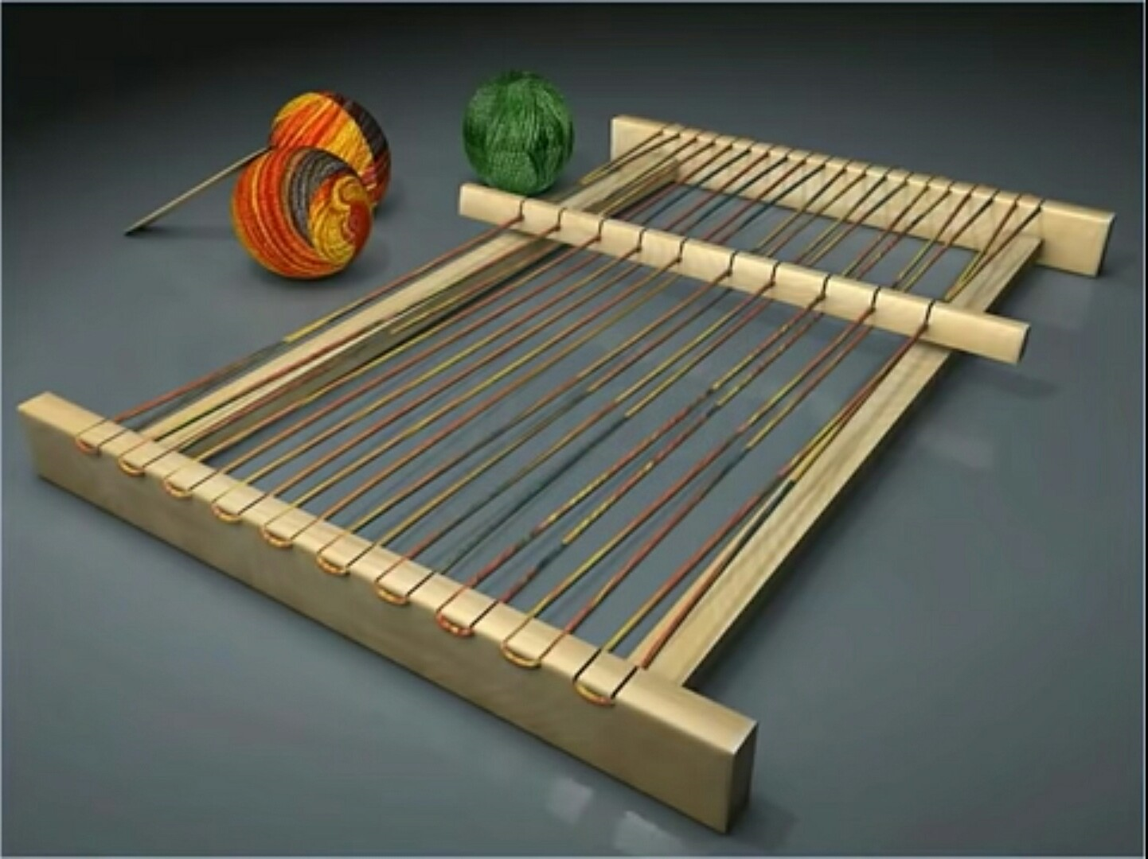
Initially one set of yarn is fitted on a loom.

Slide 23
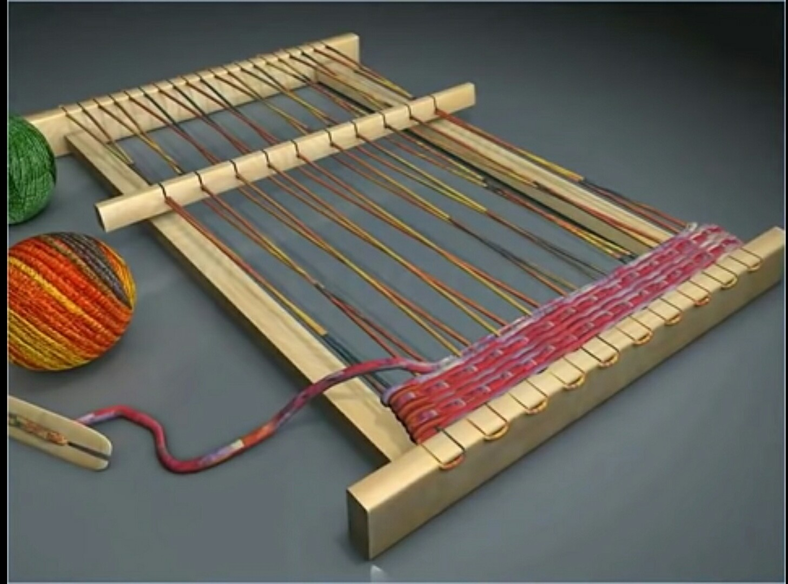
OTHER SET OF YARN IS INTERLACED AT RIGHT ANGLES WITH FIRST SET OF YARN TO GET FABRIC.

Slide 24
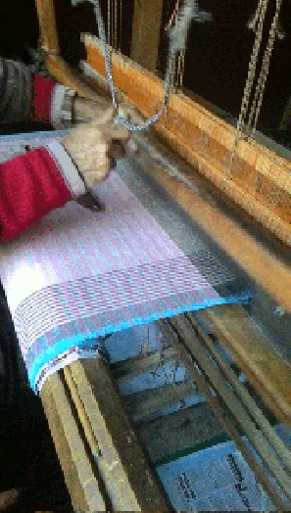
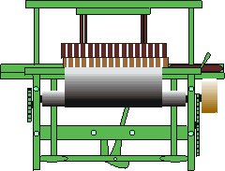
WEAVING MACHINES
HANDLOOM
POWERLOOM

Slide 25
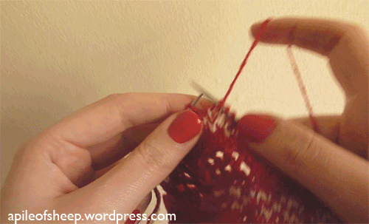
THE OTHER WAY OF MAKING FABRIC FROM THE YARN IS KNITTING
IN KNITTING A SINGLE YARN IS INTERLOOPED TO MAKE FABRIC.

Slide 26
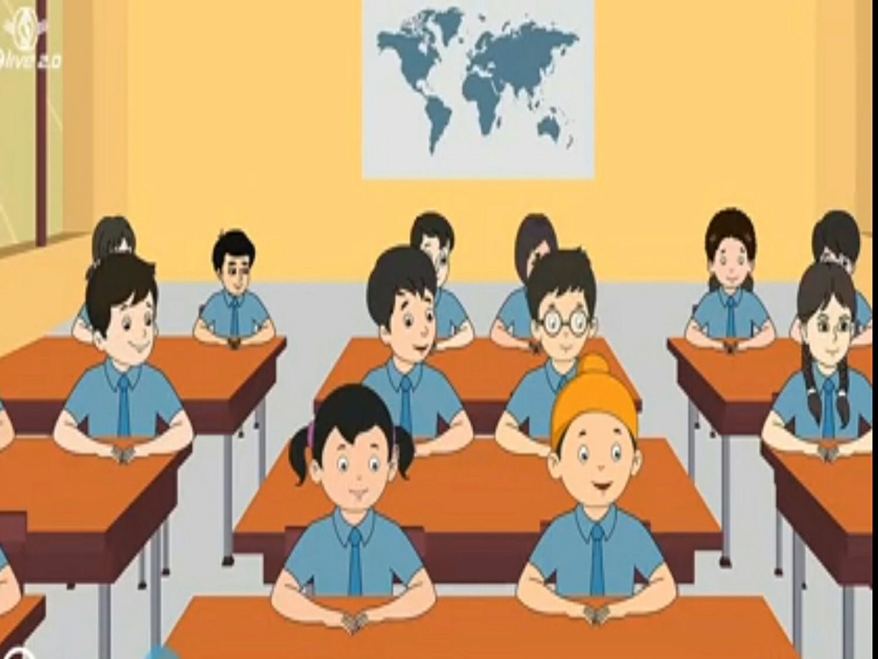

Students! I hope you have understood, how do we get cotton fabric from cotton fibre.
Yes ! Mam
How do we get jute fabric from jute plant?
Mam!
I have a question.

Slide 27
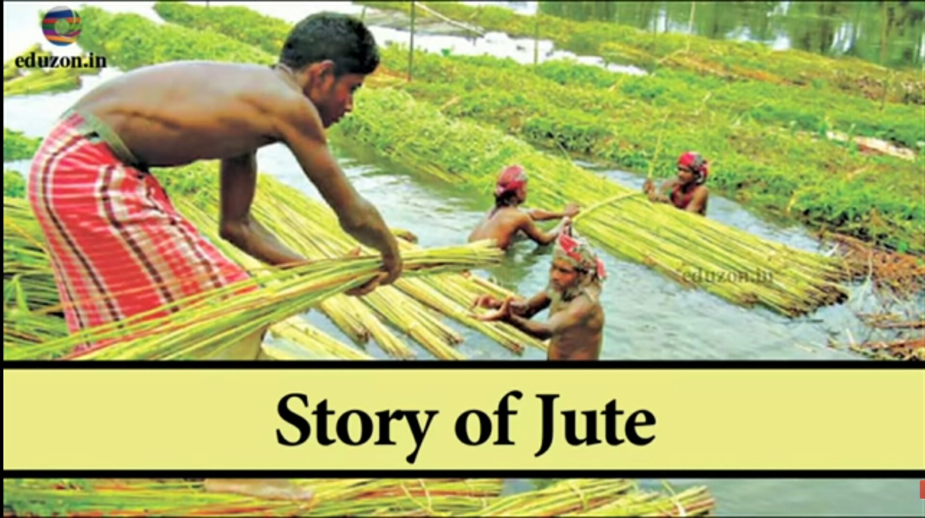

Slide 28
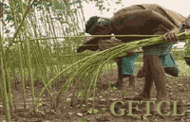
HARVESTING OF JUTE PLANT

Slide 29
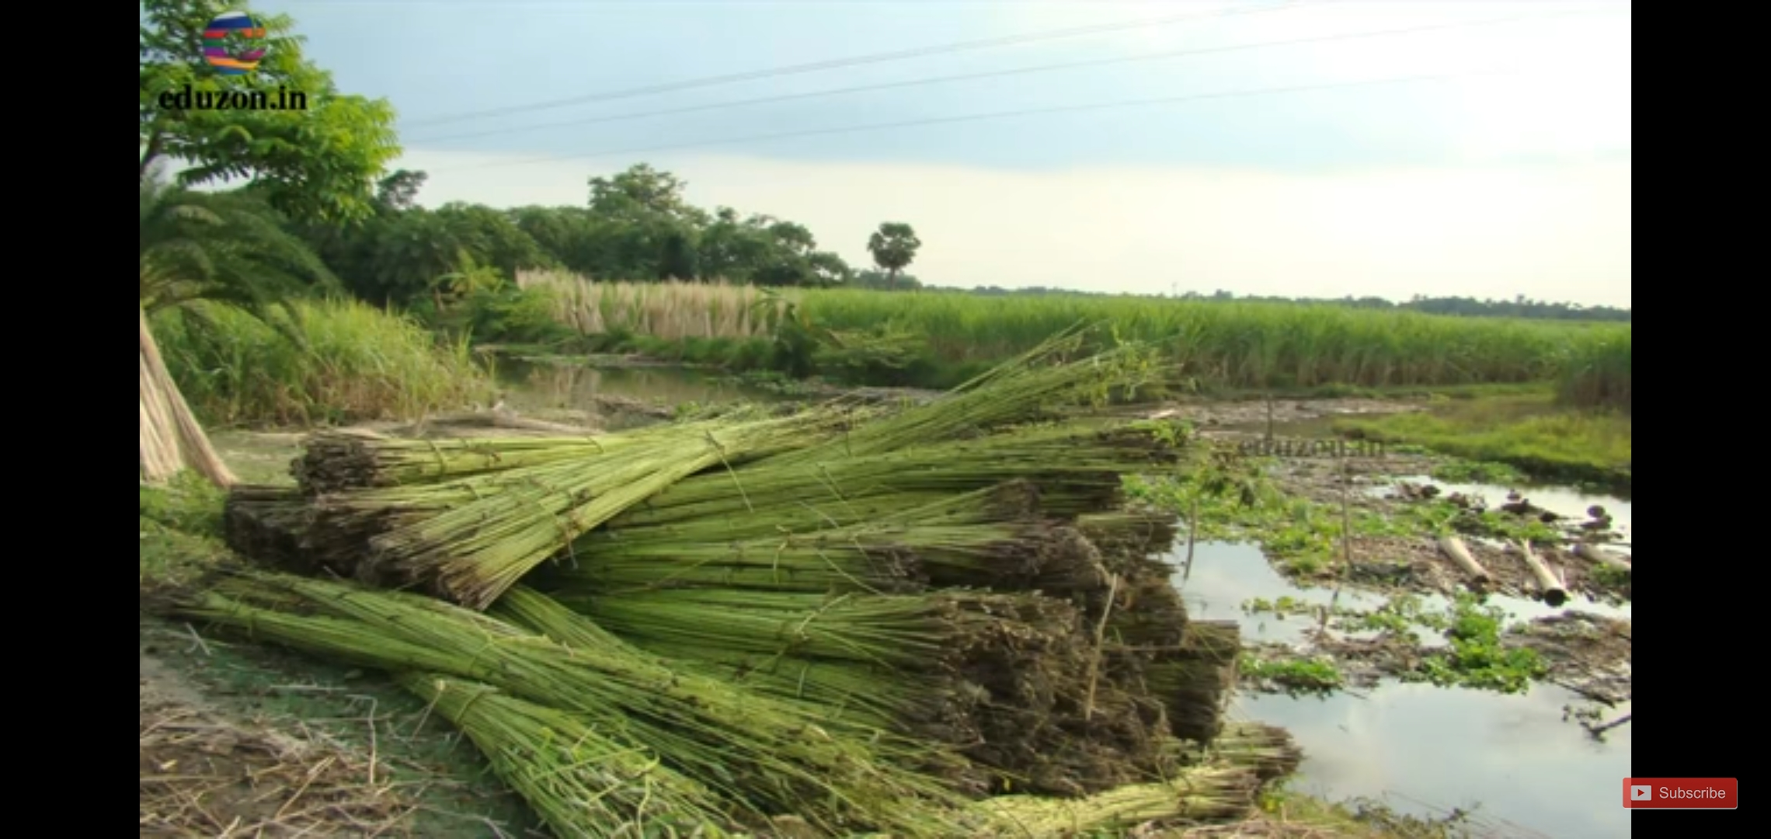
MERGING JUTE STEM IN WATER

Slide 30

AFTER PEAL COMES OUT, WE GET JUTE FIBRE

Slide 31
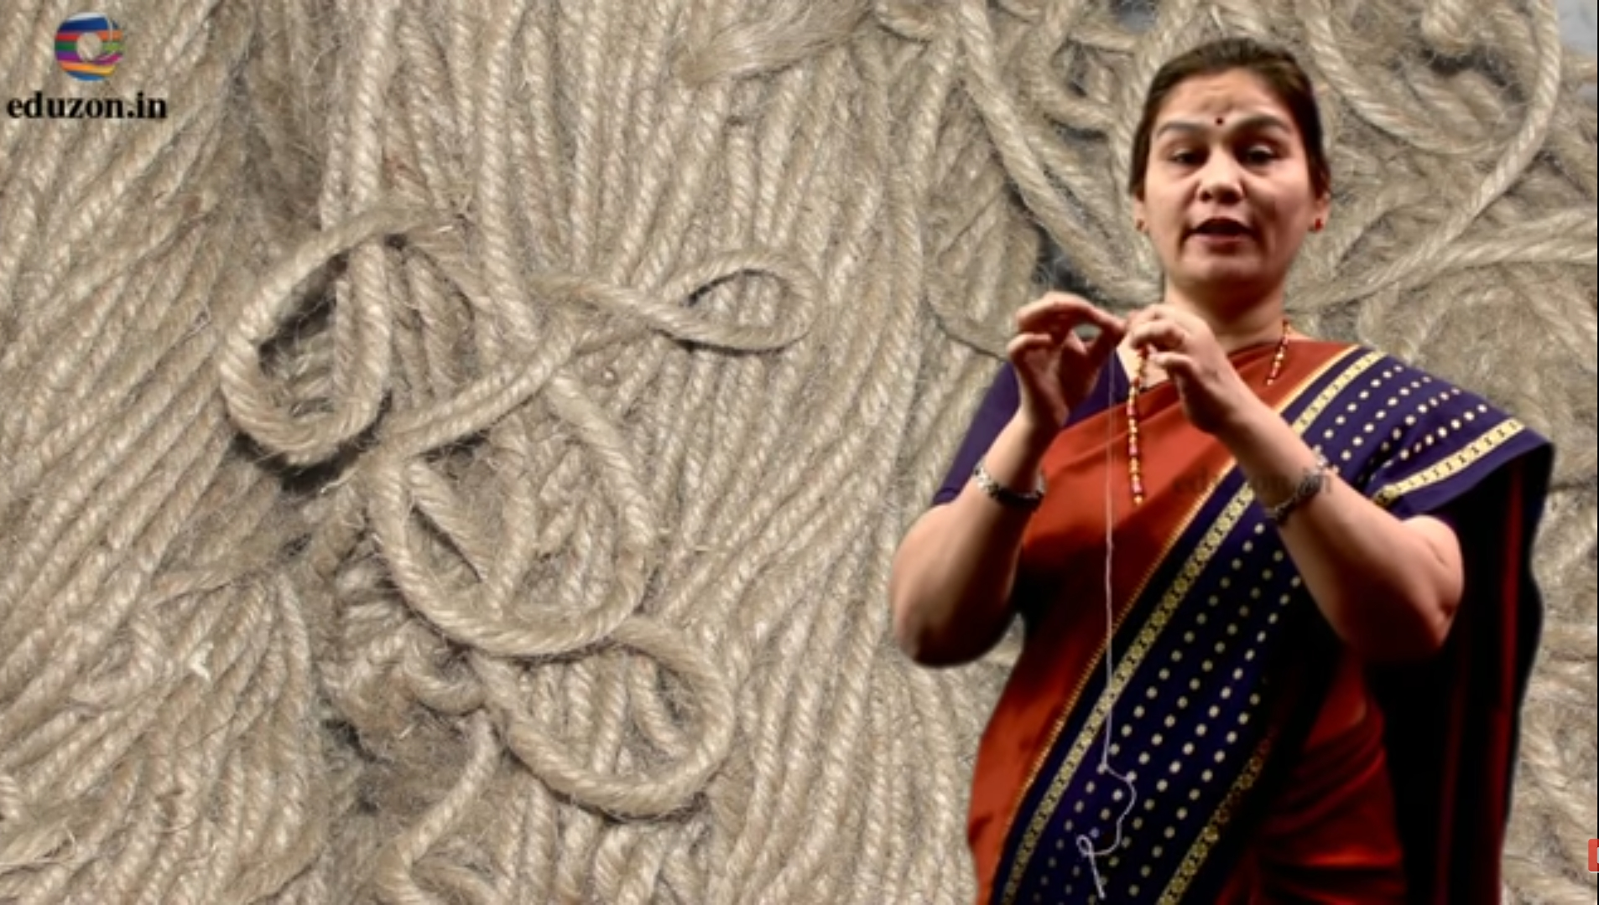
JUTE YARN IS MADE FROM FIBRE
YARN

Slide 32
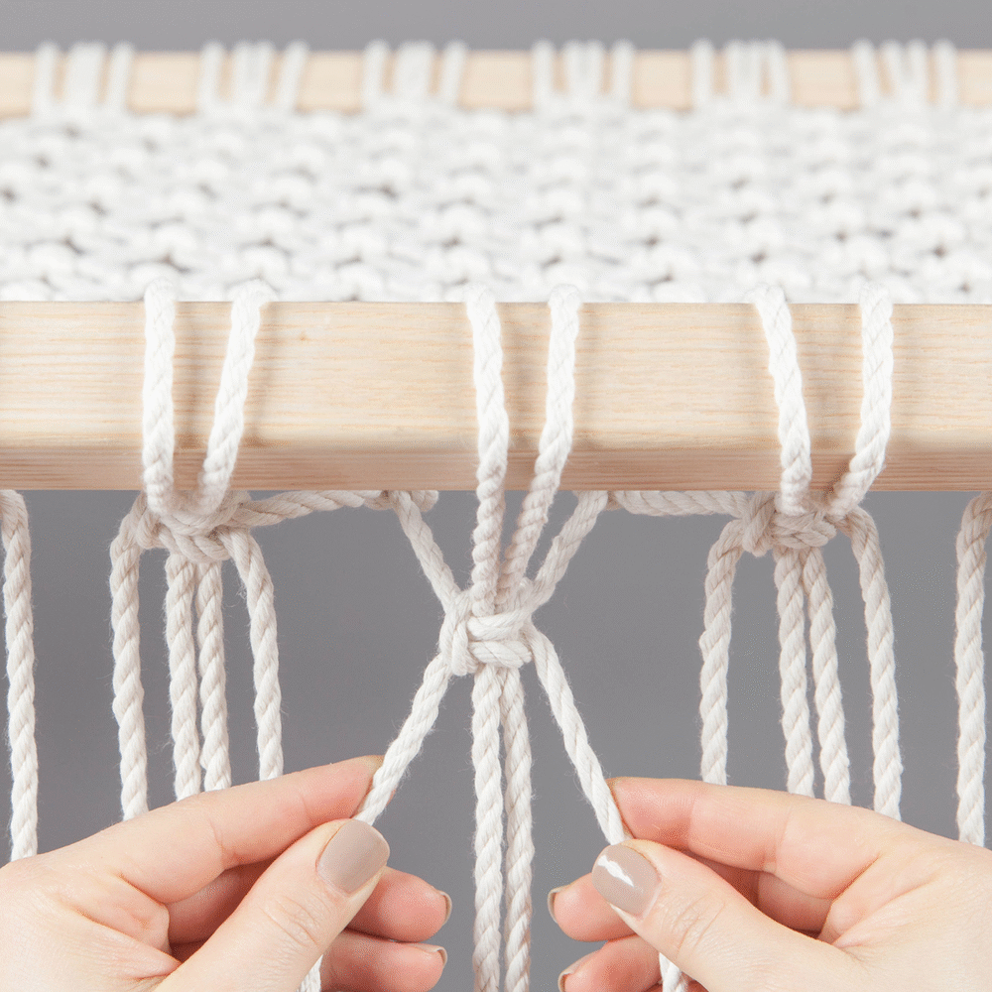
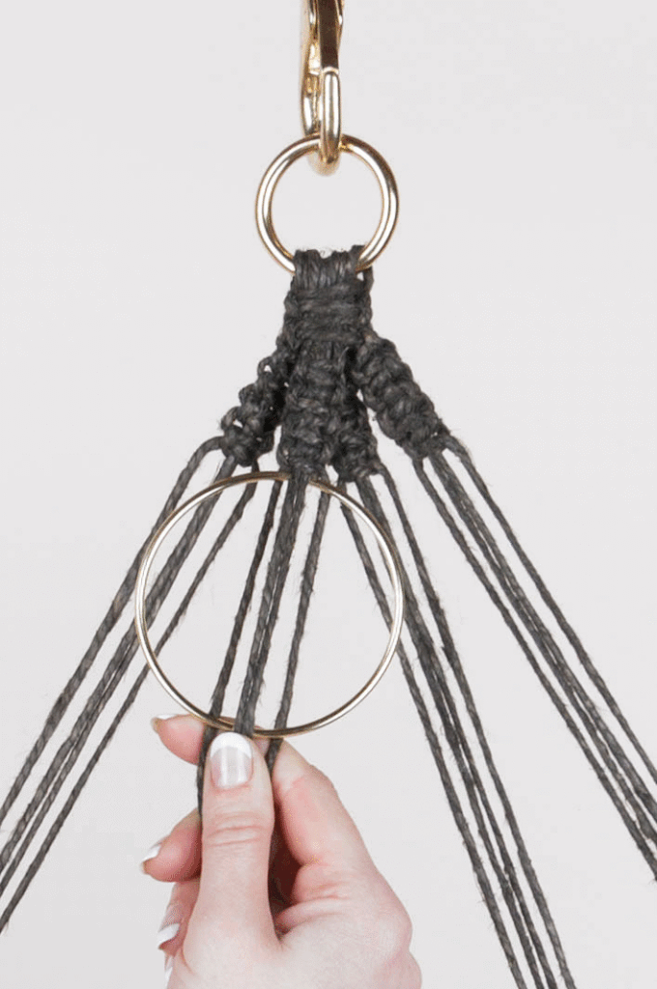
WEAVING IS DONE ACCORDING TO REQUIREMENT
MAT
WALL HANGING

Slide 33
Mam, I also want to know about animal and synthetic fabric.
Well,students ! Hope you all understand the process of making jute fabric.
Yes Mam.
Good. We will study about these in class 7 and 8.

Slide 34
LET’S RECALL
State weather the following statements are true or false:
Yarn is made from fibres. True / False
Spinning is a process of making fibres. True / False
Jute is the outer covering of coconut. True / False
The process of removing seed from cotton is called ginning. True / False
Weaving of yarn makes a piece of fabric. True / False
Polyster is a natural fibre. True/False.

Slide 35
TEST YOURSELF
Answer these questions:
From which part of the plant cotton is obtained ?
Cotton is obtained from the fruit of the cotton plant.
Name the process of making yarn from fibre.
Spinning
By which process fabric is made from yarns ?
Weaving and knitting.
What is ginning ?
The process of separating seeds from the cotton balls is called ginning.

Slide 36
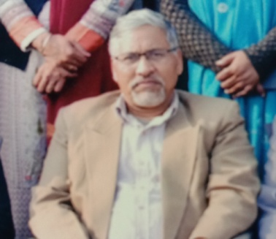
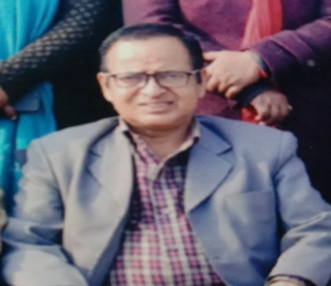
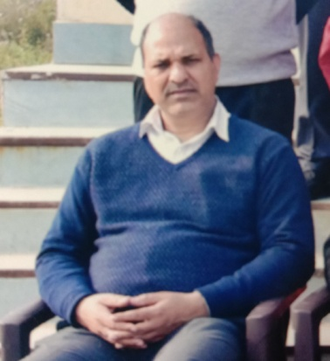
District Education & Training Institute
Udham Singh Nagar
Motivation – Mr. Dharam Singh Rawat
(D.E.I.T. Principal)
Direction – Mr. Mohan Singh Rawat
(H.O.D.- E.T. Department)
Coordination – Mr. B.P. Joshi
(Coordinator - E.T. Department)

