Slide 1
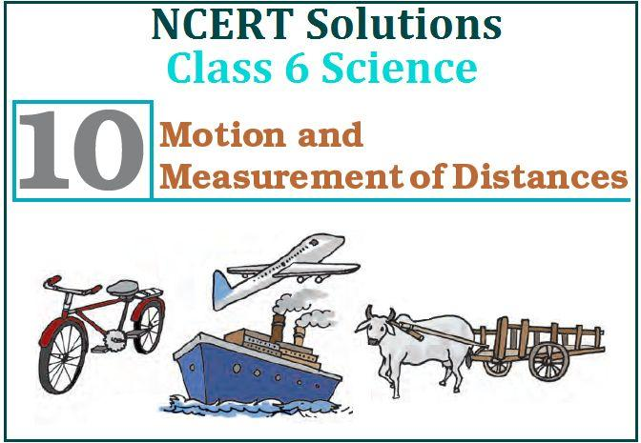


Slide 2
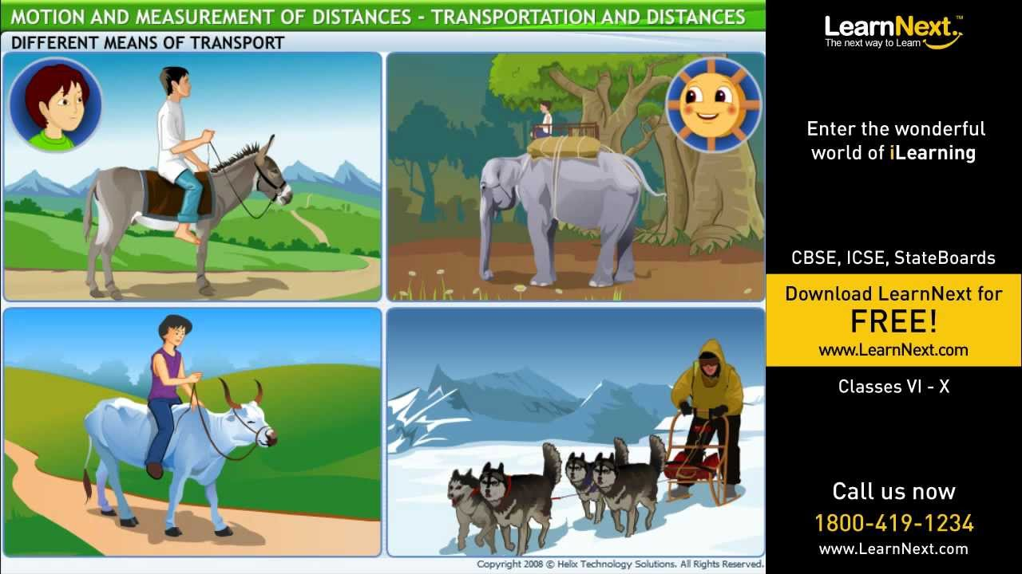
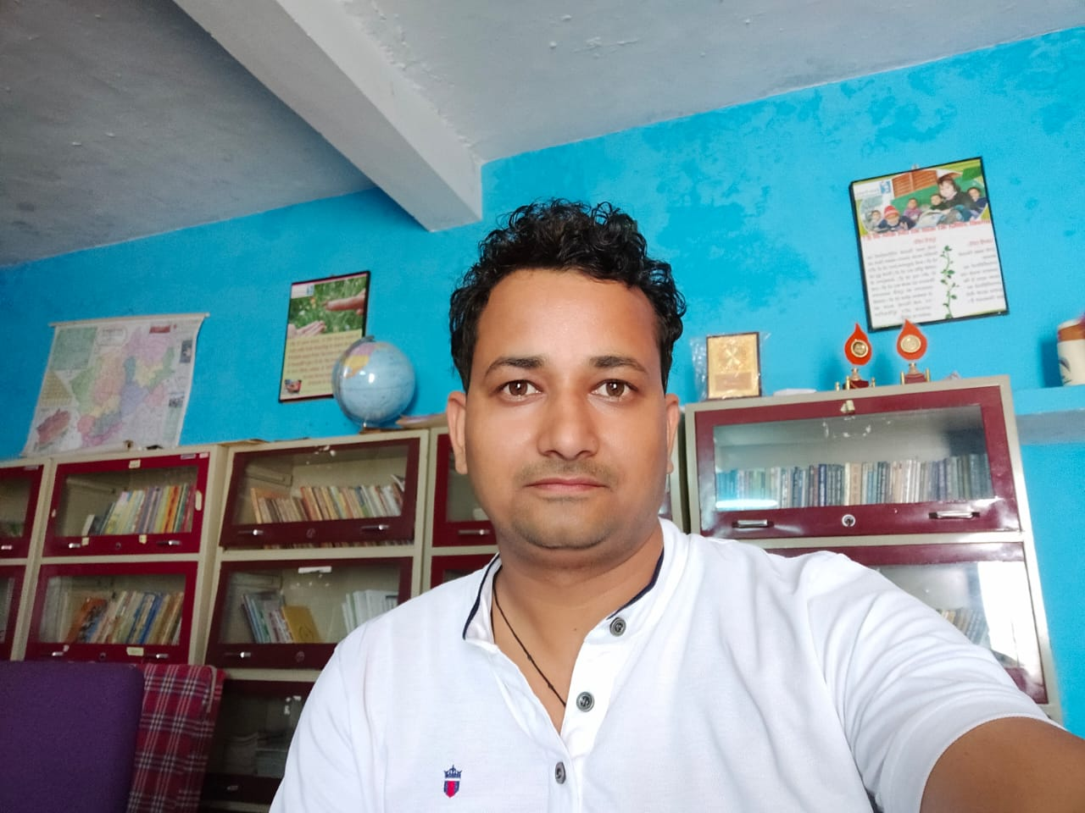
Motion and Measurment of Distances
PERSENTED BY :-
B.P. JOSHI
LECTURAR
DIET, U.S. Nagar
EDITED BY :-
JEEVAN SINGH NEGI
ASST. TEACHER
GPS BAIGULDAM KHATTA, SITARGANJ
SOUND
Mrs. RASHMI CHANDRA
ASST. TEACHER
GMPS KUNWARPUR SISAIYA, SITARGANJ

Slide 3
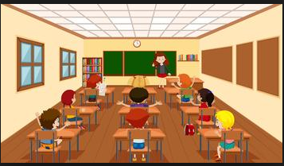
Mam I spent my holidays going on fishing trips on my uncle’s boat
Has anyone visited his or her native place during summer vacations ??
Yes mam, I visited my native village by a train, a bus and finally a bullock cart.
Mam , Mam i travelled by an aeropane

Slide 4
Do you know that during ancient times how people travelled from one place to another ??
Then listen the story of transport
No mam..
we dont know..

Slide 5
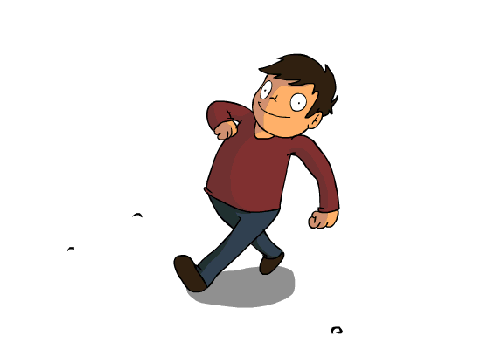
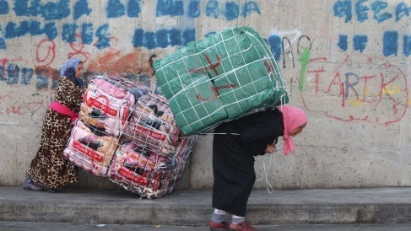
Long ago people did not have any means of transport they used only Foot ..
And they used to carry their goods on their backs

Slide 6
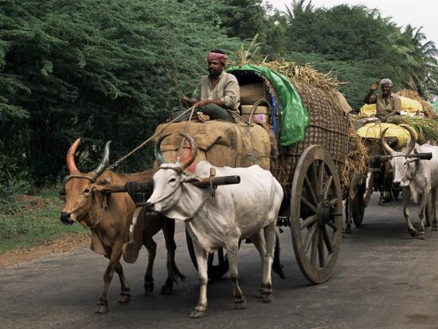
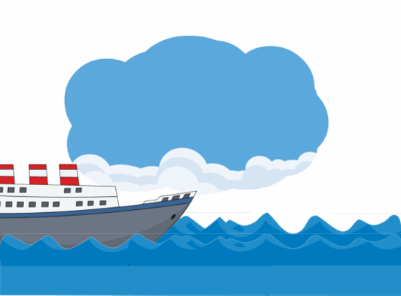
Later on they began to use
For transport through water routes boats used from ancient time
animals for Transportation
For transport through water, routes boats were used from ancient times. To begin with, boats were simple logs of wood in which a hollow cavity could be made . Later people learnt to put together different places of wood and give shapes to the boats.

Slide 7
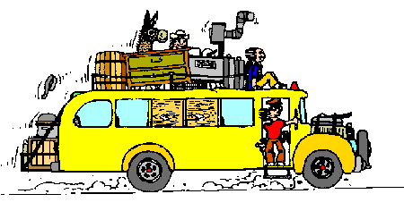
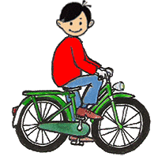
Invention of the wheel
Wheel made a great change in modes of transport. The design of the wheel was improved over thousands of years. In 19’th century people still depended on animals, boats and ships to transport.
The new innovations are
1- Rail roads and rail

Slide 8
Ma’am how did the people know how far they have travelled ?
This is very important to know how far a place is. So that we can have an idea how to reach that place.
Students lets do one activity I ask you to measure your benches.
How will we do it mam?

Slide 9
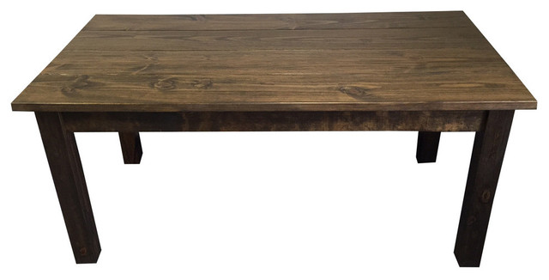
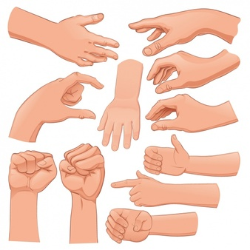
Ma’am. we have gilli and danda can we measure Table from gilli and danda ?
Oh ho!!
Now we have a new set of gilli and danda.
The desk length seems 2 danda and one gilli . A little space is still remaining.
Now what ?.
Yes please try .
The desk seems to have a length of 2 dandas and two gillies.
After few days the marked line gets wiped out .

Slide 10
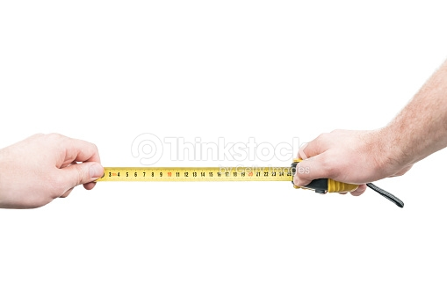
Let do one activity
All the students take your scale and measure the length of the Table through the scale.

Slide 11
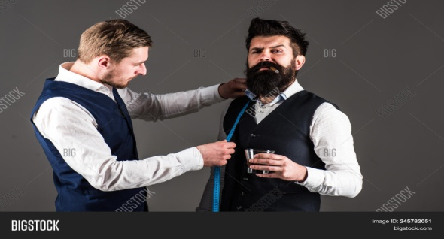
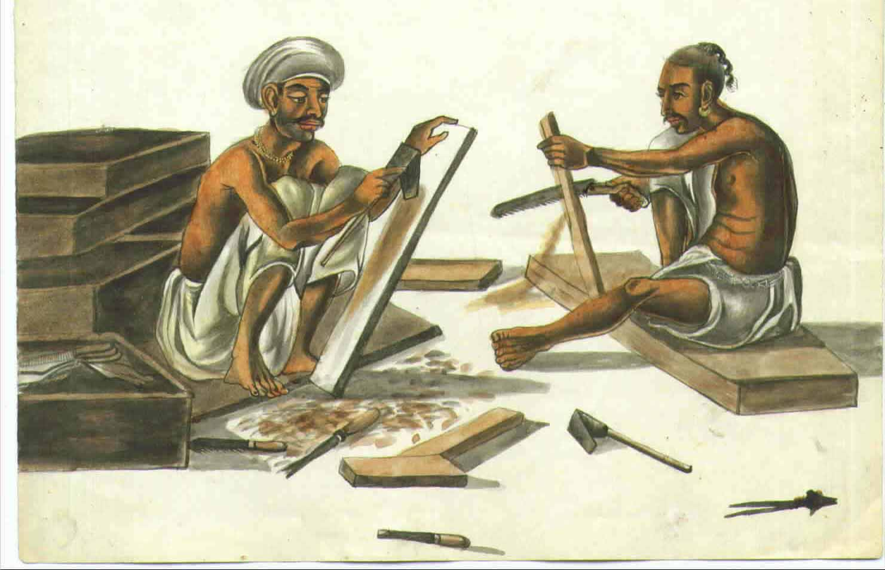
There are so many occasions when we come across a need to measure lengths and distances.
Tailor need to measure the length of The cloth to know if it is enough to stitch or not.
A carpenter need to measure the height and width of a cupboard to know how much wood he would need to make its door

Slide 12
Sudents.. We have to find the total distance of anyplace to know the exact measurement..
Ma’am how far is it from Delhi to Lucknow..?
Ma’am how far away is the Moon from the Earth?
Ma’am... What is the length of this desk and room too?

Slide 13
All these questions have one thing common. They all concern distance between two places. The two places may be close enough. Like the two ends of a table or they may be far apart. Like Jammu kashmir and Kanyakumari.
Let us do a few measurements to see what exactly we need to do. When we measure distances or lengths.

Slide 14
Some Measurements
  Each of you do this activity one by one. Using your foot as a unit of length now measure the length and breadth of the classroom. It is possible that while measuring these you may find some part remains to be measured as it is smaller than your foot.
Record your observation in the following
Name of Student | Length of Classroom | Width of the Classroom

Slide 15
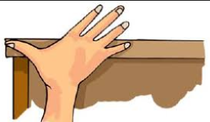
Activity 2
  Students now we will do an activity in a group of five each and each of you have to use your hand span as a unit to measure the width of a table and write the record in the following table .
Who measured the width of the table | Number of hand spans

Slide 16
The fixed quantity of measurement is called a unit.
if in 1’st activity the length of the room is found to be 12 steps of your foot then 12 is the number and foot length is the unit selected for the measurement.
The result of measurement is expressed in two part one is number and other is the unit of measurement.
now discuss about table 1 and 2

Slide 17
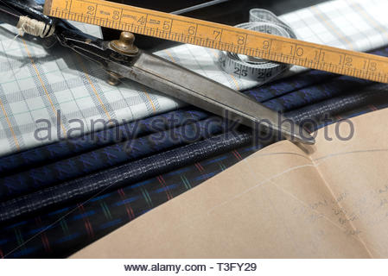
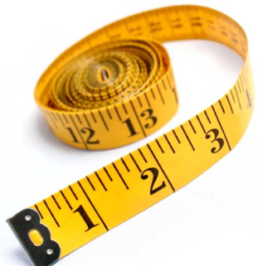
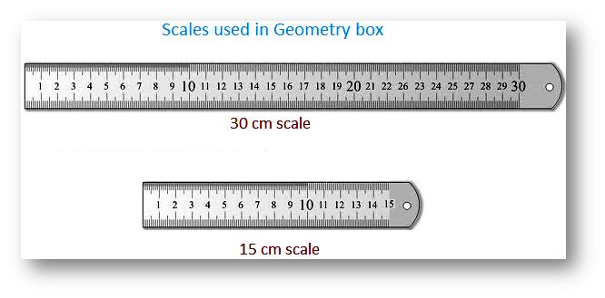
Correct Measurement of Length
Students in our daily life we use various types of measuring devices. We use metre scale for measuring length. For example

Slide 18
Every student measure your table with scale and note the right measurement in the following table.
Name of student | Measurement

Slide 19
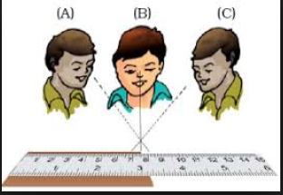
Student the correct position of the eye is also important for taking measurement . Your eye must be exactly in front of the point where the measurement is to be taken as shown in following figure (B) is correct position of the eye.

Slide 20
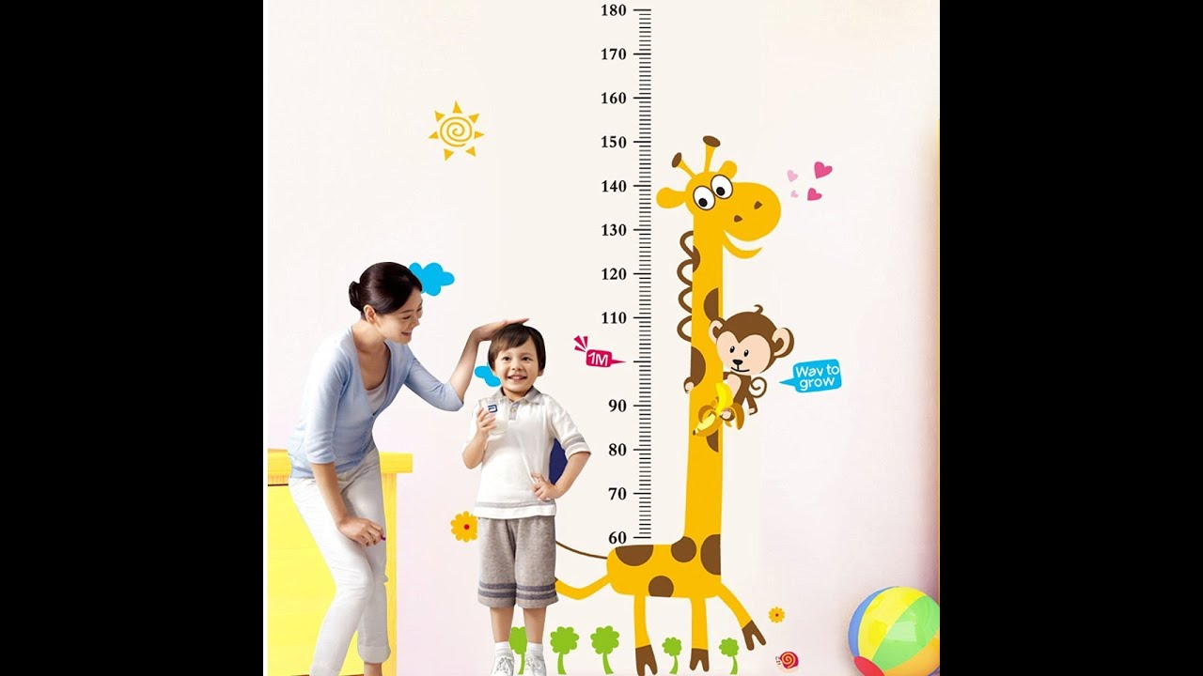
Now children let us do some Activity
Measure the height of your classmate using hand span and then by using metre scale and record observation in following table
Who measured the height? | Height in handspans | Height in cm

Slide 21
No No we can not measure the length of a curved line directly by using a metre scale
Mam can we measure the curve line with the metre scale ?

Slide 22
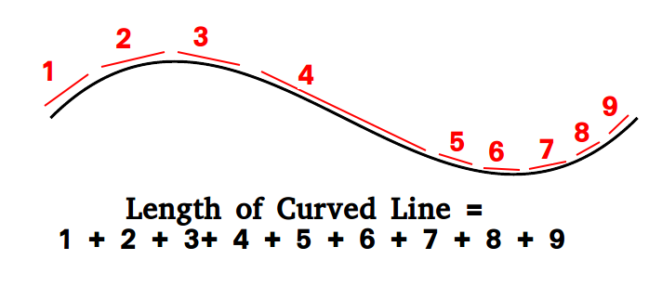
Let us do a activity. Use a thread to measure the length of the curved line. Put a knot on the point ‘A’ now place a small portion of the threada along the line. Keeping it taut using your finger and thumb. Do this activity with your friend and measure the thread
Who measured the length? | Length in cm

Slide 23
Thing of some objects you have seen recently. List them in the following table . These may include a Building, chair , dog , cow, house , factory , fish , a moving train and wall clock or the hands of a clock . Which of these are moving which are at rest
Object at rest | Object in motion
Table | Dog

Slide 24
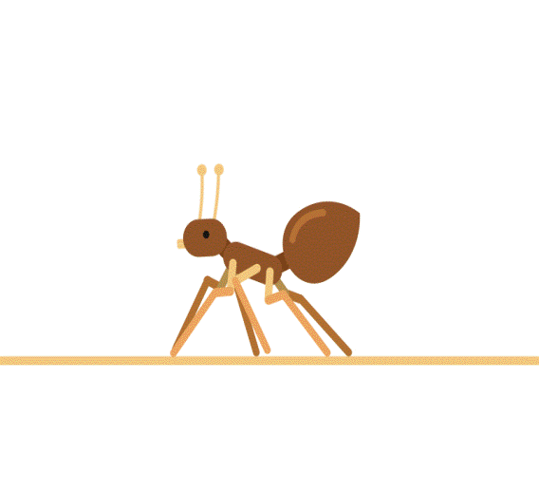
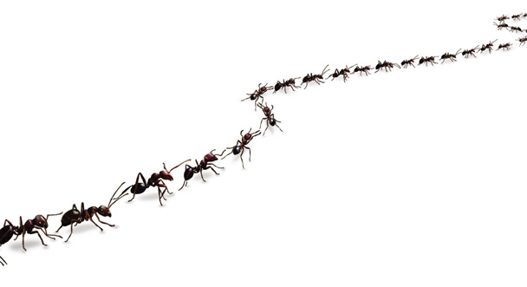
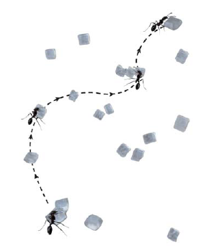
Let us look at the motion of an ant closely .
Select a place where you find ants. Spread a large sheet of white paper on the ground and keep a little sugar on it. Ants are likely to be attracted to the sugar and you will find many ants crawling on the sheet of paper soon. For any one ant. Try and make a small mark with a pencil near its position when it has just crawled on the sheet of paper. Keep marking its position.

Slide 25
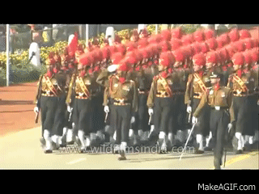
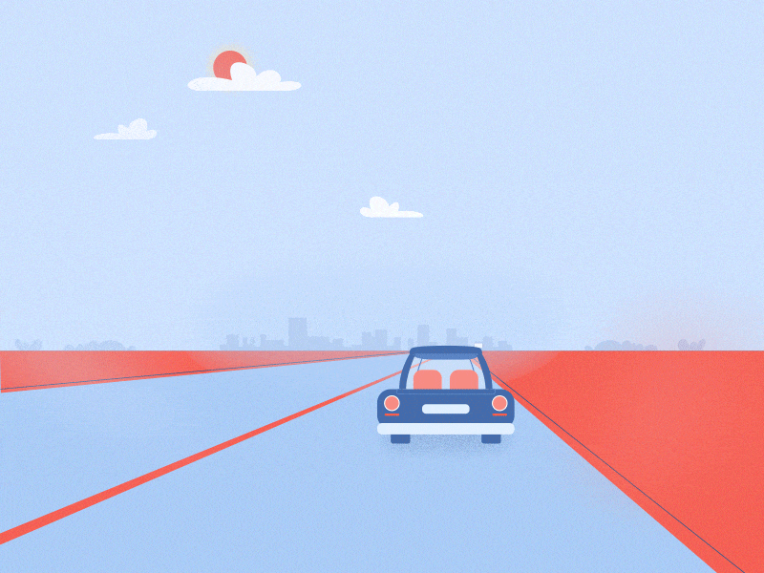
Type of Motion
March past
Vehicle on a straight road
Think and Write some more Example of Motion

Slide 26
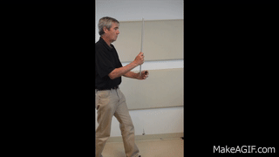
OK . Take a stone, tie a thread to it and whirl it with your hand. Observe the motion of the stone
Do you Know what is circular motion
No mam

Slide 27

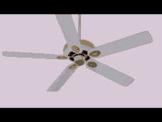
Ma’am can you give me some example of circular motion

Slide 28
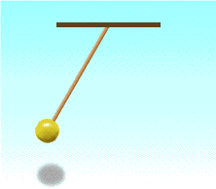
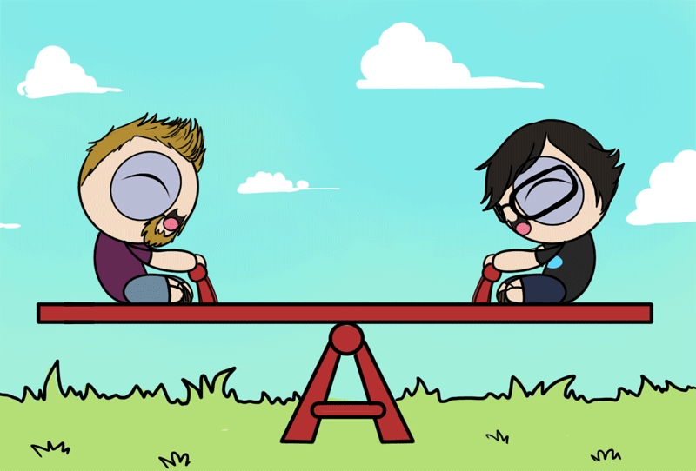
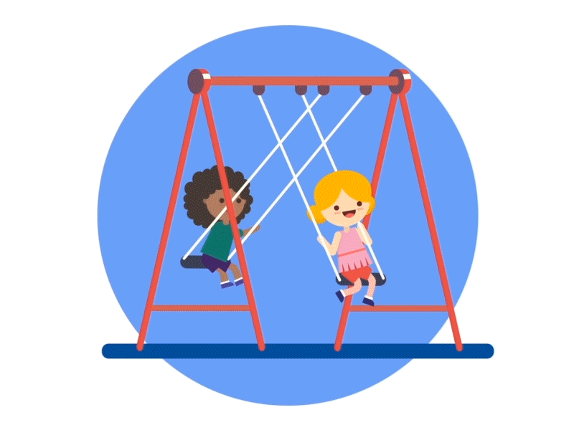
If an object repeats its motion after some time this type of motion is called periodic motion

Slide 29
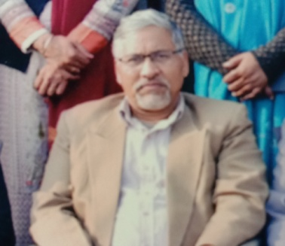
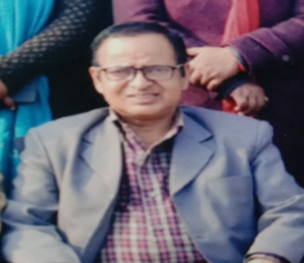
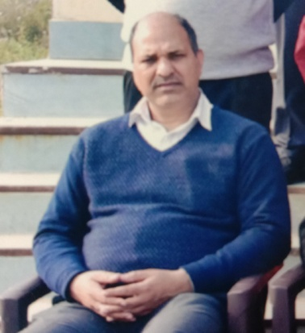
District Education & Training Institute
Udham Singh Nagar
Motivation – Mr. Dharam Singh Rawat
(D.E.I.T. Principal)
Direction – Mr. Mohan Singh Rawat
(H.O.D.- E.T. Department)
Coordination – Mr. B.P. Joshi
(Coordinator - E.T. Department)

